Slide 1
The Postulates of Quantum Mechanics
Evin O’Shea - 2017

Slide 2

Review/Background
Vectors
Basis Vectors
Vector projection and orthogonality
What is an operator?
Matrices (Ax=y)
Differentials ($\frac{d}{dx}$)
What are eigenvalues/eigenvectors?
Ax = $λ$x
x is eigenvector
$λ$ is the eigenvalue

Slide 3

Evidence of Quantum Mechanics
There is a LOT, it makes accurate predictions and has wide-reaching applications
Spectral lines (quantized energies)
(recall $E=hν=\frac{hc}{λ}$ )
Stern and Gerlach experiment

Slide 4
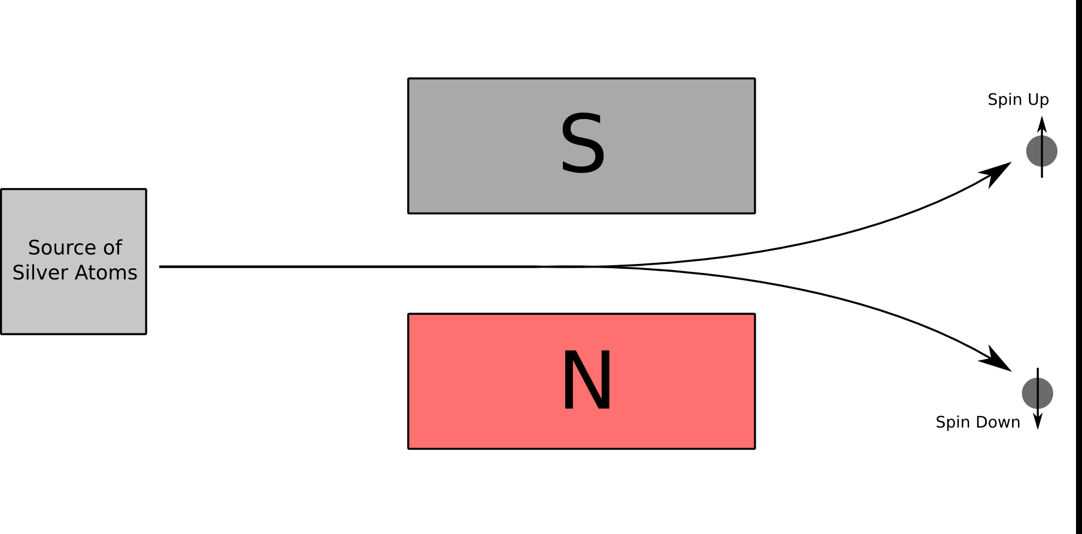
Stern and Gerlach

Slide 5
The State of a System
The state of a system is specified by a vector
The vector contains all of the information about the state
The state exists in a Hilbert space
Completeness, orthogonality

Slide 6

Observables and Operators
For all physically observable quantities (A), there exists an linear, (Hermitian) operator operator ($\hat{A}$) whose eigenvectors from a complete basis.
These operators will correspond to the action (operation) of measurement of a system.

Slide 7

Measurements and Eigenvalues of operators
Measurement of observable A is represented by the action of $\hat{A}$ on a state vector |$ψ(t)$>
The only possible result of a physically measurement is one of the eigenvalues of $\hat{A}$
If eigenvalue $a_{n}$is measured, then the state immediately after measurement will be |$ψ_{n}$>:
$\hat{A}\left|ψ_{n}> = a_{n}\right|ψ_{n}>$

Slide 8
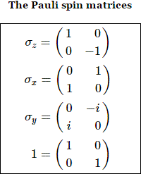

Stern and Gerlach Revisited
Now, lets look at the underlying operator.
We model the Stern and Gerlach showed with the matrices:
For example look at $σ_{z}$, the spin-z operator is $\frac{ℏ}{2}σ_{z}$
The eigenvalues are +/- 1, eigenvectors are: <1, 0>, <0, 1>

Slide 9

Probabilistic Outcome of Measurements
When measuring an observable A of a system in state |$ψ$>, the probability of obtaining one of the eigenvalues $a_{n}$ of the corresponding operator $\hat{A}$ is given by:
$P_{n}\left(a_{n}\right)=\frac{\left(\left|<ψ_{n}\right|ψ>{\left.​\right|}^{2}\right)}{<ψ| ψ>}$
This is vector projection onto the basis state-vectors of the operator $\hat{A}$

Slide 10

Stern and Gerlach, again!
So a (spin-1/2) particle in the “x spin-up” state corresponds to: $\frac{1}{\sqrt{2}}$<1, 1>
What is the probability of measuring a particle in the z spin-up or spin-down?
$\frac{{\text{|}\frac{1}{\sqrt{2}}\text{<1, 1> . <1, 0>}|}^{2}}{\frac{1}{\sqrt{2}}\text{<1, 1>} .\frac{1}{\sqrt{2}}\text{<1, 1>}}$ = ??

Slide 11


Time Evolution of a System
The time evolution is given by the Schrodinger Equation:
$$iℏ\frac{∂}{∂t}\left|ψ\left(t\right)> =\hat{H}\right|ψ\left(t\right)>$$
Furthermore the Schrodinger equation is often written (because H = E)

Slide 12

Interpretations of Quantum Mechanics
The Copenhagen interpretation
“It works, it’s a model, don’t ask me questions”
Decoherence
Do I lose information?
Well, no. You forgot about your giant instrument that consists of ~${10}^{alot}$particles (a lot ~ 25)

